Slide 1
Decision tree algorithm using CHAID hyperparameter tuning

Slide 2
AGENDA
Problem statement
Description about columns
EDA
preprocessing
Building model
Hyperparameter tuning

Slide 3
Problem statement
Thera Banks a US bank that has a growing customer base. The majority of these customers are liability customers (depositors) with varying sizes of deposits. The number of customers who are also borrowers (asset customers) is quite small, and the bank is interested in expanding this base rapidly to bring in more loan business and in the process, earn more through the interest on loans. In particular, the management wants to explore ways of converting its liability customers to personal loan customers

Slide 4
Description about columns
ID: Customer ID
Age: Customer’s age in completed years
Experience: #years of professional experience
Income: Annual income of the customer (in thousand dollars)
ZIP Code: Home Address ZIP code.
Family: the Family size of the customer
CCAvg: Average spending on credit cards per month (in thousand dollars)
Education: Education Level. 1: Undergrad; 2: Graduate;3: Advanced/Professional
Mortgage: Value of house mortgage if any. (in thousand dollars)
Personal_Loan: Did this customer accept the personal loan offered in the last campaign?
Securities_Account: Does the customer have securities account with the bank?
CD_Account: Does the customer have a certificate of deposit (CD) account with the bank?
Online: Do customers use internet banking facilities?
CreditCard: Does the customer use a credit card issued by any other Bank (excluding All life Bank)?

Slide 5
EDA-Exploratory data analysis
The following EDA steps have been performed on the dataset.
Observed some basic statistics of the dataset by describe() function
Null values were also checked. Observed that few columns had more than 30% of null values. Keeping this as threshold columns having more than 30% of null values were dropped.
Datatypes of the columns were also checked to make sure that the datatypes are in such a way that supports the model
Also checked outliers and correlation were also cheched

Slide 6
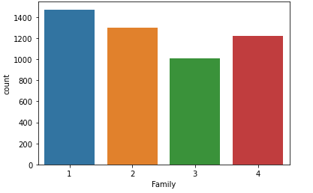
This bar chart tells us members in a family

Slide 7
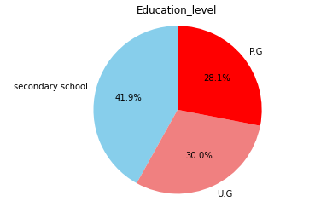
This pie chart describes about education level of customer

Slide 8
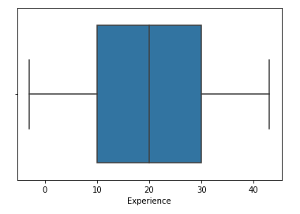
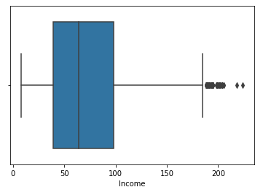
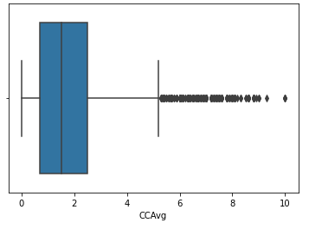
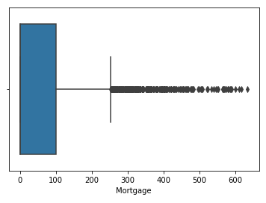
Box plot for outliers

Slide 9
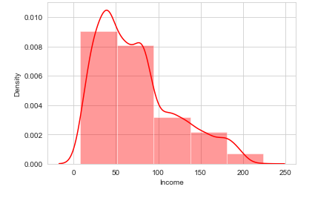
Distribution of income of customers

Slide 10
PRE-PROCESS
Firstly, some columns like "ID","ZIP Code","CCAvg","Mortgage" were dropped as they do not help in model building and has outliers more than distribution of data.
Secondly, all the categorical columns were encoded.(as the values were strings)
And we converted “Income” into bins as we need only categorical data for our algorithm.
We droped some columns based on their corelation.
After the Pre-processing steps were done, The data was split into Train and Test with the help of Scikit learn library.

Slide 11
Building the model
fit(self, X, y):This function takes X and y as arguments and y is target variable and concatenate X and y columns to single dataframe, then builds the tree.
predict(self, X): This method predicts target variable for X
build_tree(self, data): This function recursively builds the decision tree. If the target variable has only one unique value it returns the value as leaf node otherwise it loops through each and every variable and calculates chi-square for every variable the variable which has lowest p value gives best split. If p-value is grater than alpha value then its returns mode of target variable, otherwise it creates new node and repeats the process
_split_data(self, data, variable) : Tts splits the given data into groups based on the values of the variable. It uses the groupby method and returns the list of data frames.
_traverse tree(self, row): This method transverse the decision to predict the target variable for single input row. Its starts root of the tree and iteratively selects the next node based on values of decision variable in row. When it reaches the leaf node it returns the value.

Slide 12
Hyperparameter tuning
Alpha = Specifies the significance level (alpha) for splitting nodes. The value must be between 0 and 1. Lower values tend to produce trees with fewer nodes. Significance level for merging. Specifies the significance level (alpha) for merging categories.
min_samples_split = The minimum number of samples required to split an internal node.
max_depth: This determines the maximum depth of the tree.

Slide 13
THANK YOU
M.Jayanth
ML Engeneer

